Slide 1
Log Based Method for Faster IoT Queries
TENSYMP 2017
Anubha Jain, Trupti Padiya, Minal Bhise
DAIICT

Slide 2
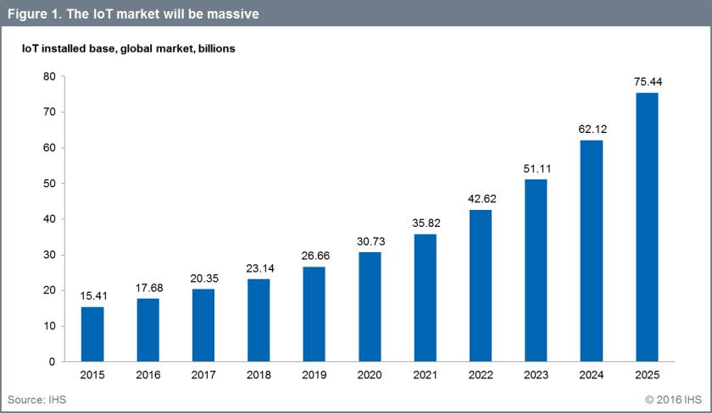
Problem
IoT market growth from 15.4 billion devices in 2015 to 30.7 billion devices in 2020 and 75.4 billion in 2025 [1]
An efficient solution required to store data collected by these devices
[1] Sam Lureco, “IoT Platforms: enabling the Internet of Things,” IHS Tech., London, U.K., Mar. 2016.

Slide 3
Problem
RDF is accepted as a standard format for storing IoT data
RDF allows exchange of data among devices
It allows cross-domain data to interact and build smart applications
IoT data can be stored in a relational format in 3 column schema (subject, property, object) called triple table
As data size is huge practical queries require a number of self joins
A better approach is to partition the data in smaller tables

Slide 4
Problem
In any IoT based system, non-uniform access pattern of its data
Natural skewedness – some records are naturally preferred over other
Data ageing – newer records are preferred over older records
Frequently accessed records solve most of the system workload

Slide 5
Solution
Partitioning IoT dataset based upon access frequency of records
Dataset
Hot data Cold data
Most queries can be answered using hot data partition

Slide 6
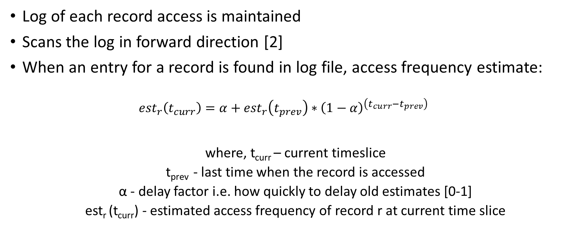
Log Based Method
Log of each record access is maintained
Scans the log in forward direction [2]
When an entry for a record is found in log file, access frequency estimate:
$${est}_{r}\left(t_{curr}\right)=α+{est}_{r}\left(t_{prev}\right)∗{\left(1−α\right)}^{\left(t_{curr}−t_{prev}\right)}$$
where, t_{curr} – current timeslice
t_{prev} - last time when the record is accessed
α - delay factor i.e. how quickly to delay old estimates [0-1]
est_{r} (t_{curr}) - estimated access frequency of record r at current time slice

Slide 7
Log Based Method
Calculate estimate access frequency of each unique record
Hot records - K records with highest estimated access frequency
Separate hot set of records from the cold set
Parallel Algorithm
Divide log into n sections, where n= number of distinct records
Assign a thread to each log section
Implement forward algorithm in each thread in parallel
Find threads with top K% estimated access frequency

Slide 8
Experimental Setup
Data set: LinkedSensorData and LinkedObservationData ^{[3]}
Query set: 20 queries
Query frequency assigned using zipf distribution
Top 50% queries are frequent queries
Top 50% of frequent queries are most frequent queries

Slide 9
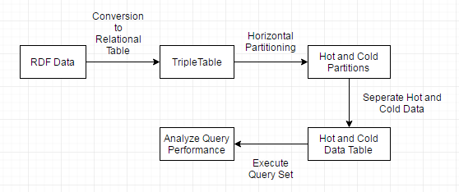
Experimental Flow

Slide 10
Hot Data and Workload Answered
Query specification | % of queries answered using 8% hot data | % of total workload answered using 8% hot data
All queries | 64 | 78.8
Frequent queries | 75 | 84
Most frequent queries | 100 | 100

Slide 11
Query Execution Time QET
Average QET for all queries:
For Triple table : 28.59sec
For Partitioned table : 4.89sec
Average QET for frequent queries:
For Triple table : 65sec
For Partitioned table : 3.46sec
Average QET for most frequent queries:
For Triple table : 3.4sec
For Partitioned table : 1.45sec
Query specification | Time gain (in %)
All queries | 83
Frequent Queries | 94
Most Frequent Queries | 58

Slide 12
Algorithm Scaling

Slide 13
Conclusion
Log Based Method LBM used to partition IoT dataset
Skewedness in data access pattern exploited to partition data into hot data and cold data
Using 8% hot data:
64% queries answered
78% system workload answered
83% time gain achieved
LBM parallel execution 69% faster than serial execution

